Slide 1
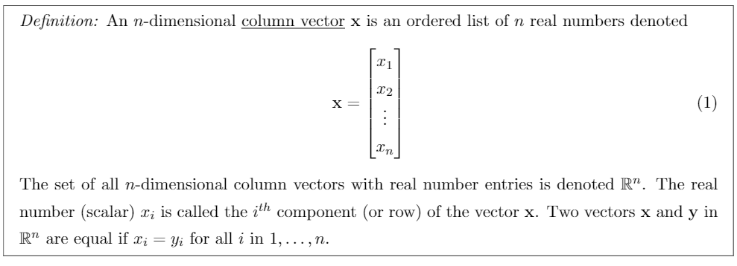
Column Vector

Slide 2
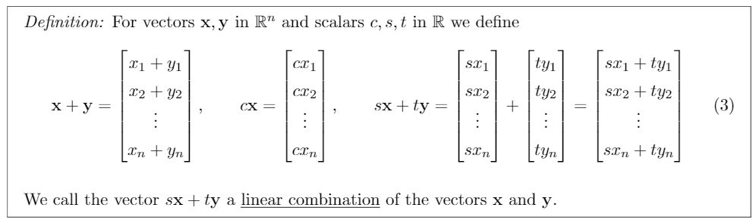
Linear Combination

Slide 3
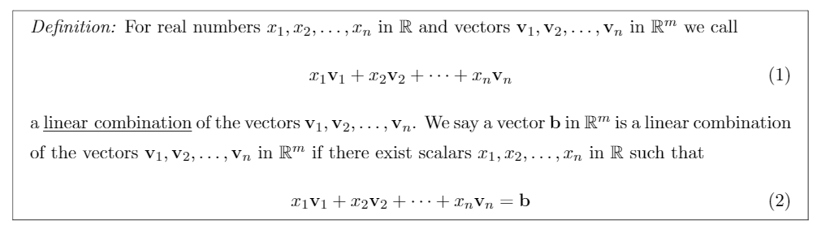
General Linear Combination

Slide 4
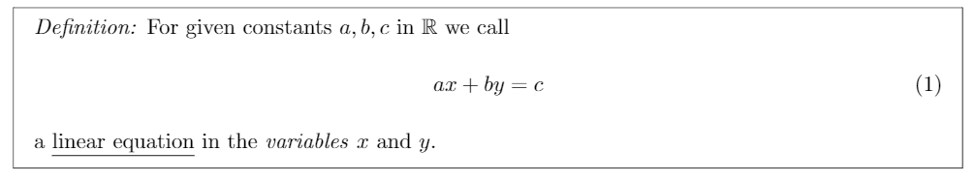
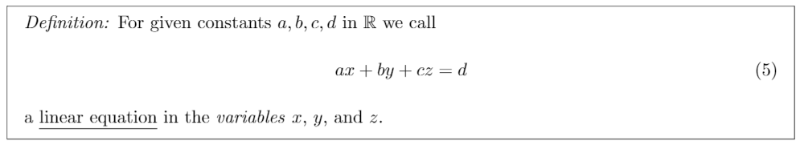
Linear Equation

Slide 5
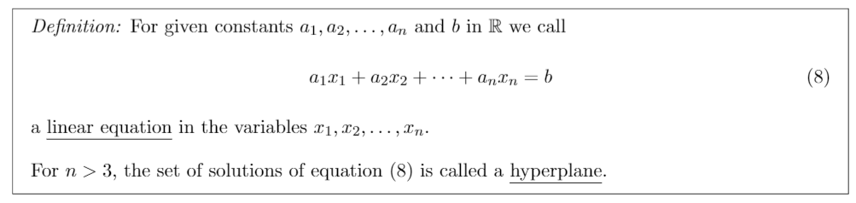
Hyperplane linear equation

Slide 6
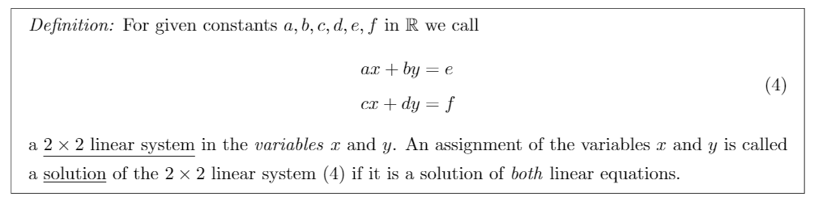
2x2 Linear System
Notes:
There is a 3x3 linear system equation that is very similar to this one. That definition is omitted due to redundancy

Slide 7
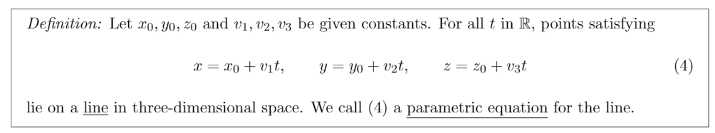
Parametric Equation

Slide 8
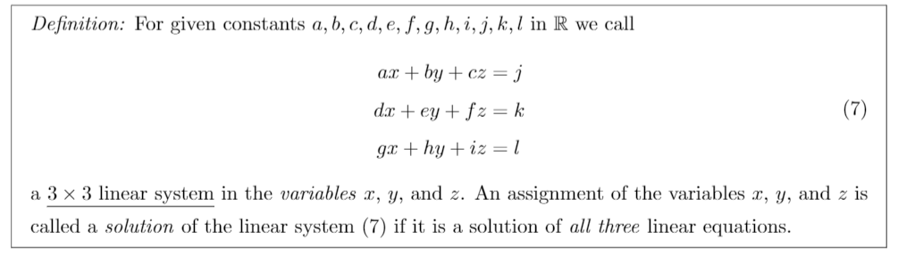
Linear System Solution Requirement

Slide 9
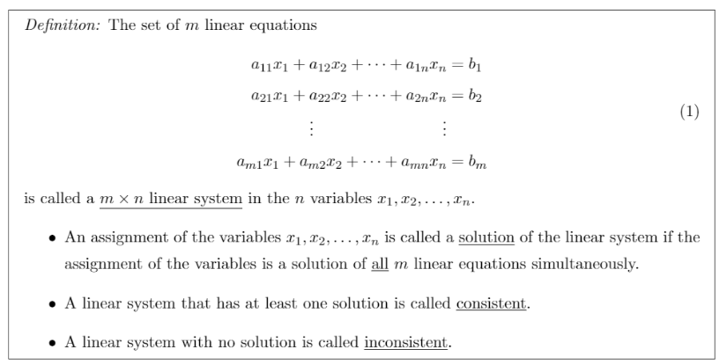
Linear System Types

Slide 10
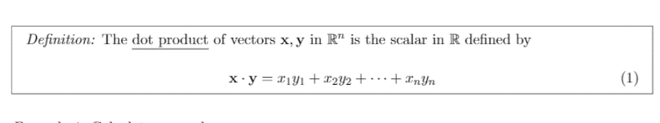
Dot Product

Slide 11
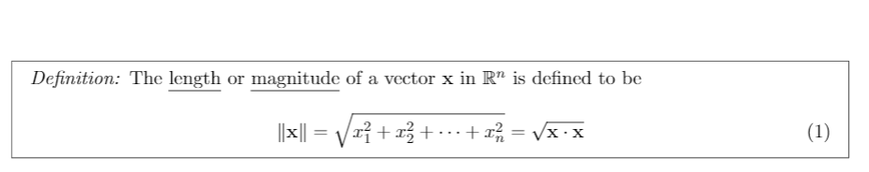
Vector Magnitude

Slide 12
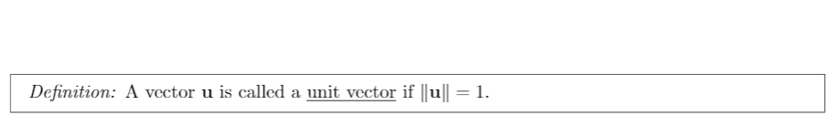
Unit Vector

Slide 13
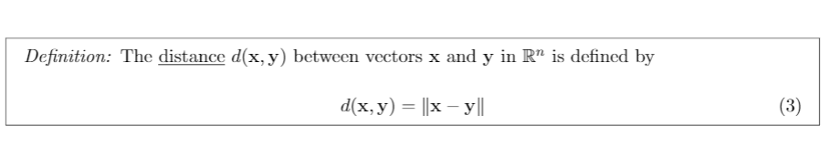
Distance Function for Vectors

Slide 14
Orthogonal Vectors

Slide 15
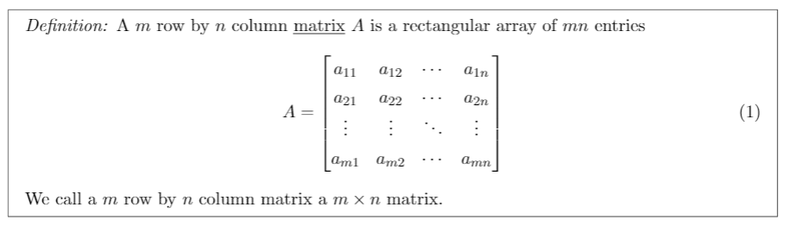
Matrix

Slide 16
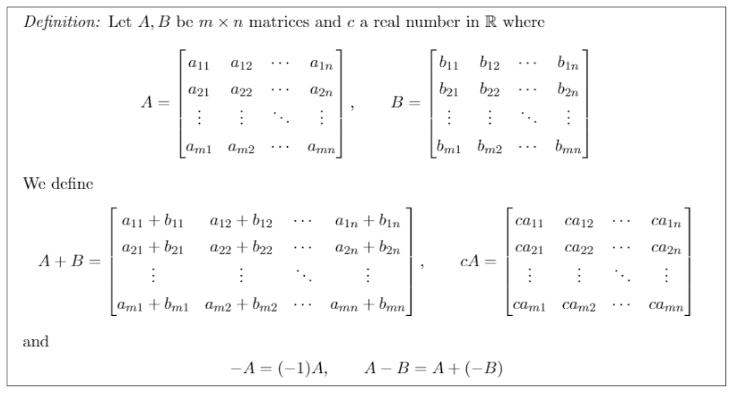
Matrix Operations

Slide 17
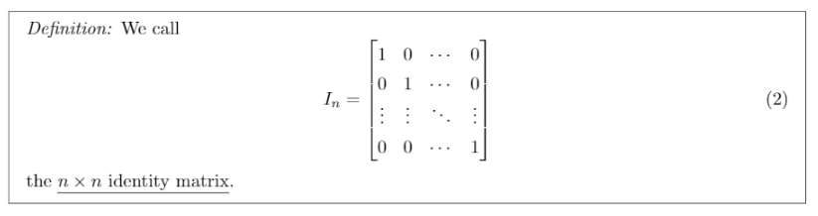
Identity Matrix

Slide 18
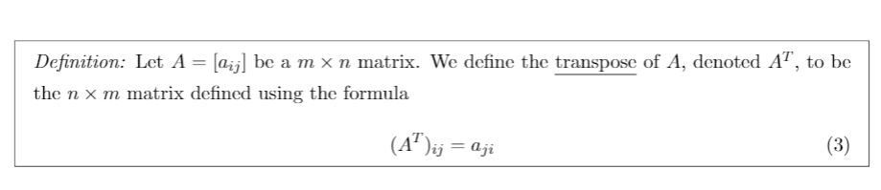
Transpose Matrix

Slide 19
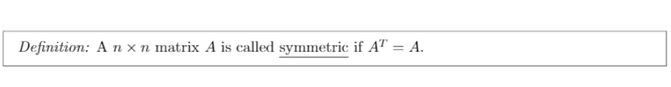
Symmetric Matrix

Slide 20
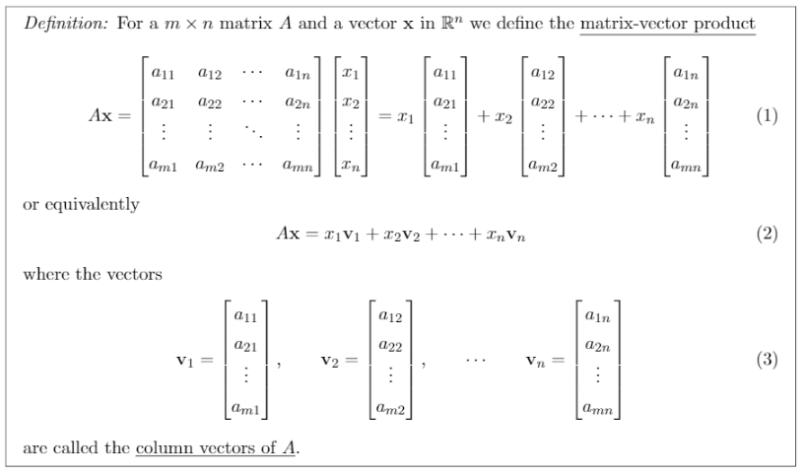
Matrix Vector Product

Slide 21
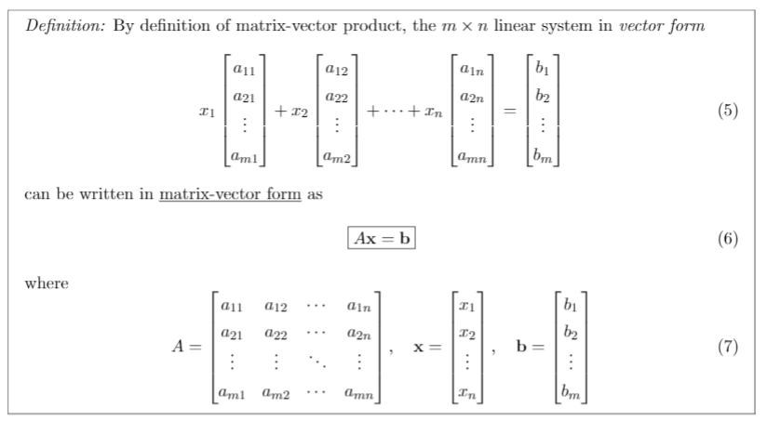
Matrix Vector Form

Slide 22
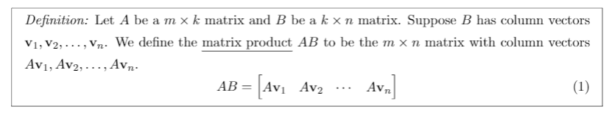
Matrix Multiplication

Slide 23
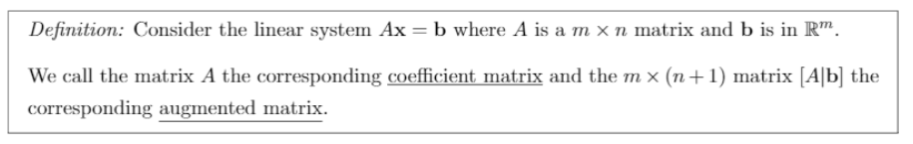
Coefficient Matrix

Slide 24
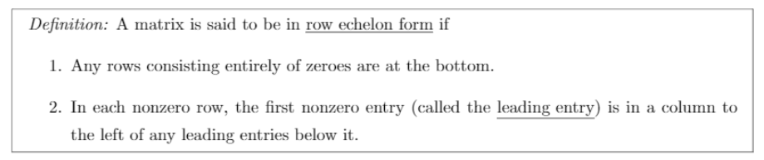
Row Echelon Form

Slide 25
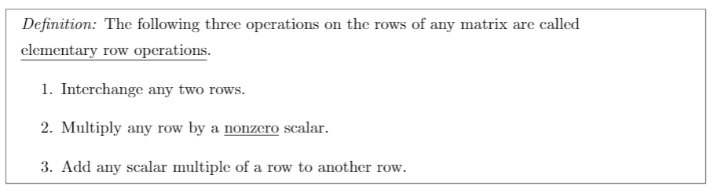
Elementary Row Operations

Slide 26
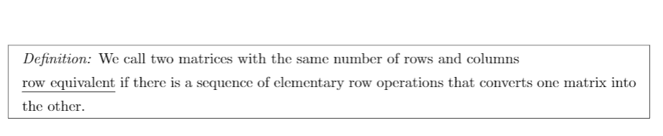
Row Equivalent

Slide 27
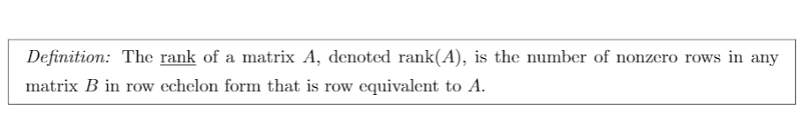
Matrix Rank

Slide 28
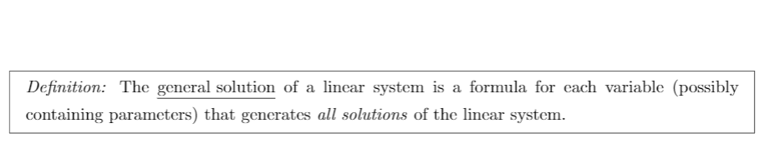
General Solution

Slide 29
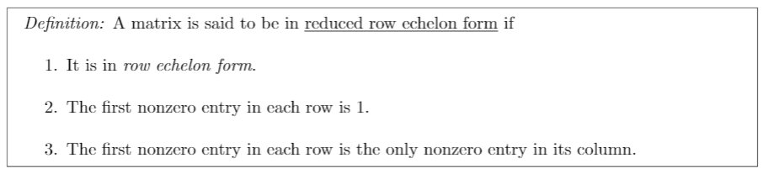
Reduced Row Echelon Form

Slide 30
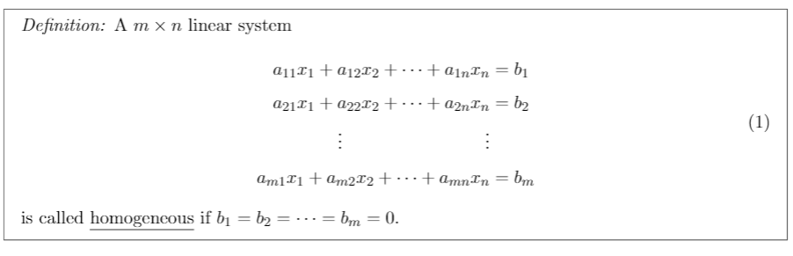
Homogenous Linear System

Slide 31
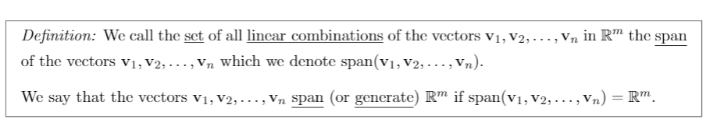
Span
Notes:
There’s another span definition that only has text. Not included in the pptx.

Slide 32
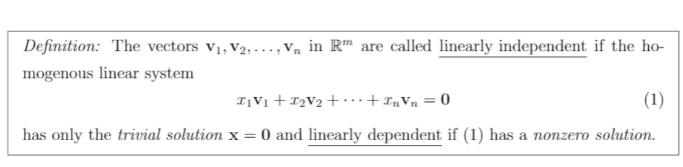
Linear Independence and Dependence

